Slide 1

Optimizing LangChain Pipelines for Trust, Observability, and Compliance
Audit-Ready RAG for Banking and Regulated Domains
Sivakumar Mahalingam
Notes:
Introduce yourself briefly.
Set context: “Today we’ll see how to make AI pipelines safe enough for banking regulators.”

Slide 2



Why Trust, Compliance, and Observability Matter?
TRUST
COMPLIANCE
OBSERVABILITY
Prevent hallucinations & enforce citations
Mask PII, follow jurisdiction rules, avoid policy violations
Full traceability for audits and debugging
Notes:
A single compliance failure can cost millions in fines.
AI cannot be a black box in regulated domains.
These 3 pillars form the backbone of safe AI.

Slide 3

Optimization Importance

Slide 4

The Banking Challenge
Analysts and agents need fast answers (KYC, AML, fees)
Knowledge is scattered: PDFs, policies, SOPs, product docs
Wrong or non-compliant answers = regulatory risk
Naive pipelines suffer from latency, hallucinations, and lack of auditability, impacting reliability and user confidence.
Notes:
Set up problem context.
Highlight pain points: hallucination, PII leaks, policy drift.

Slide 5
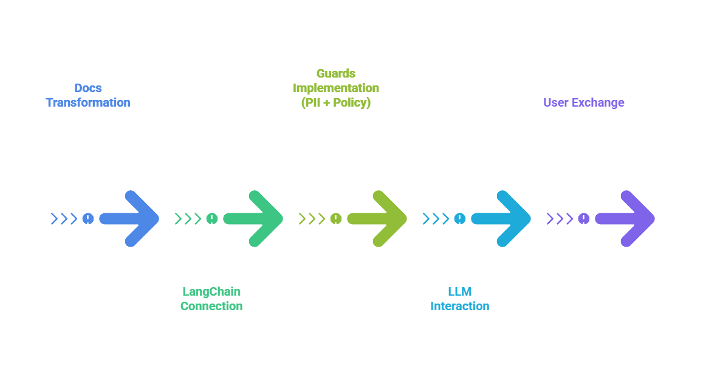

Audit-Ready RAG Copilot
Retrieval-Augmented Generation with guardrails
Jurisdiction-aware policy enforcement
Full LangSmith traceability & replay
This is not just RAG, it’s RAG with governance
Ensures every answer is backed by citations
Notes:
Set up problem context.
Highlight pain points: hallucination, PII leaks, policy drift.

Slide 6
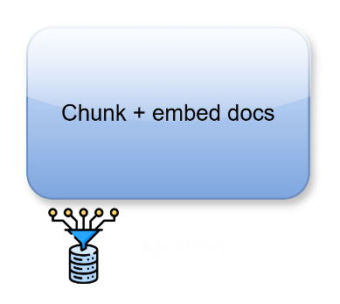
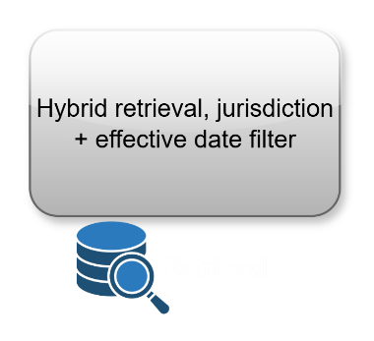
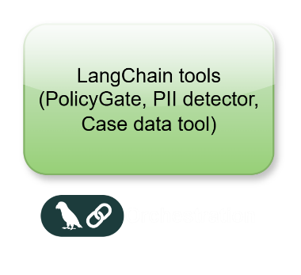
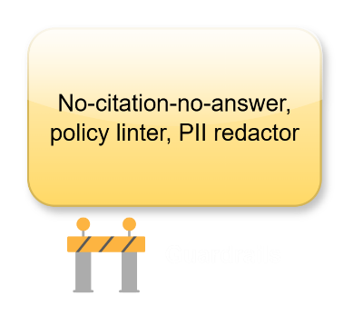
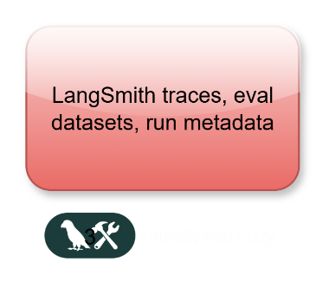
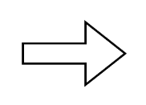
Architecture Overview

Slide 7
Code Repository Layout
app/
├─ chains/
├─ guards/
├─ retrieval/
├─ policies/
├─ schemas/
├─ server/
└─ telemetry/
# LangChain graphs & tools
# PII, policy linter
# Indexer, retriever
# Policy packs
# Pydantic models
# FastAPI endpoints
# LangSmith client

Slide 8

How Guardrails Work?
PII Redaction: Masks PAN, IBAN, SSN, EID pre + post generation.
Policy Linter: Blocks banned phrases like “guaranteed approval”
No Citation, No Answer: Refusal if no supporting docs
Example:
Input: “4242 4242 4242 1234”
Output: “**** **** **** 1234”
Guardrails — the backbone of trust and compliance in this system

Slide 9

Observability with LangSmith?
Every run logged with:
Inputs, retrieved docs, tool calls, outputs
Metadata: jurisdiction, policy_pack_version, timestamp
Replay past runs for audits

Slide 10
THANK YOU
Questions & Discussions

